Slide 1
Introduction to Primrose
April 2025
Notes:
[*]

Slide 2

Our mission is to bring simplicity and clarity to our clients on their AI transformation journey.
Notes:
[*]

Slide 3

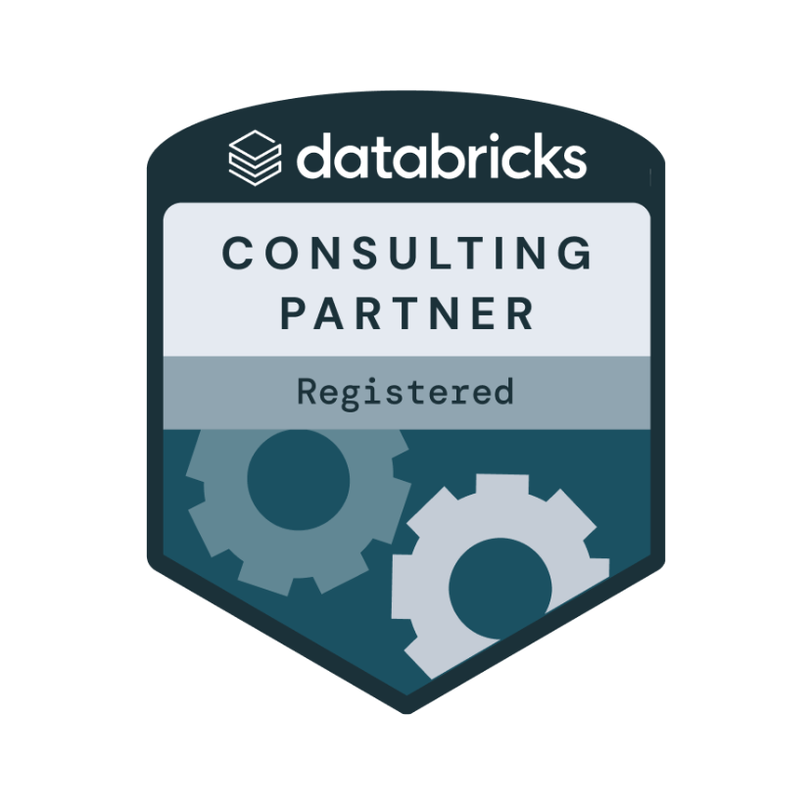
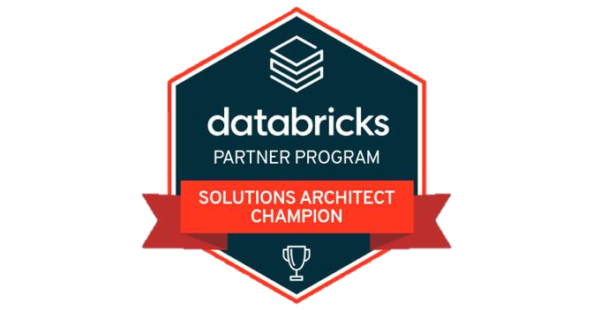
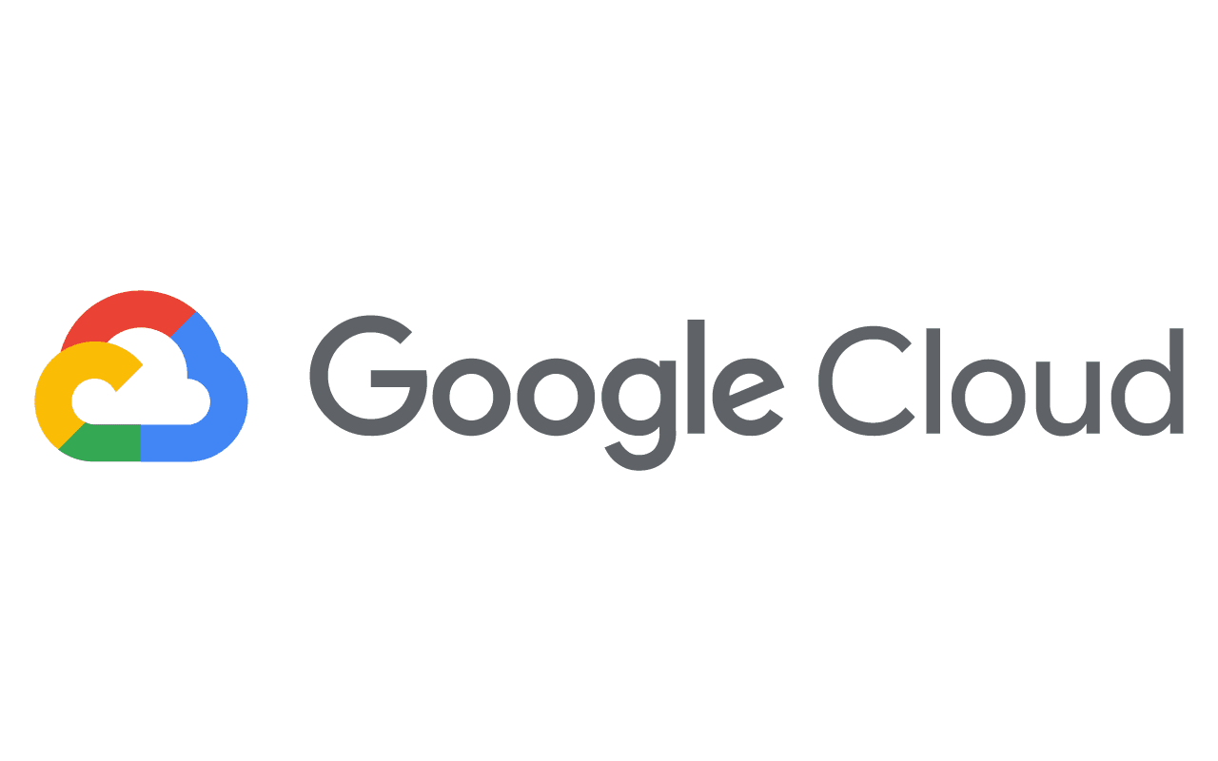


Introduction
Primrose is a specialist Data & AI consultancy focused on helping businesses unlock value from their data. As a new and ambitious consultancy, we are investing in client success to build long-term partnerships that benefit our clients, partners and our growth.
We have deep expertise in both data & AI and Databricks technology, enabling us to design and deliver high-impact Databricks solutions that drive tangible outcomes.
Why Work with Us?
✅ Partnership Approach – As a growing consultancy, we are willing to invest in relationships, align to client goals, and build shared success.
✅ Data & AI Excellence – Our team combines advanced data engineering, analytics, and AI skills with the ability to understand the business objectives.
✅ Specialist Databricks Expertise – We focus on implementing Databricks solutions to maximise platform adoption and business value.
✅ Commitment to Success – We work on fixed-price engagements, demonstrating our confidence in delivering high-quality outcomes.
Our Preferred Data Platform
On Any cloud
Notes:
[*]

Slide 4
How Primrose supports Databricks sales teams
Vendor Neutral
Industry Knowledge
People & Process
Data Skills
Clients value independent opinions over the vendors which can be perceived as bias.
Primrose understands competitor vendors and can compare the merits of Databricks.
We understand the client's industry with visibility of what competitors are doing.
This allows us to demonstrate the market momentum from the ground.
We ensure implementations align to business objectives, delivering value quickly to senior leadership.
Primrose drives a Data & AI Strategy agenda which creates a long-term vision, enabling commits.
The success of a data platform requires foundational and specialist data skills. From designing good data assets to implementing FinOps, MLOps and SecOps that work within the given organisation.
Databricks Internal Use Only
Notes:
[*]

Slide 5





The Primrose Difference
Client Centric
Outcome Driven
Domain Knowledge
Strong Partnerships
Price
1
2
3
4
5
We Partner for the long-term.
Our success is measured by your success and returning custom.
We are unique in that we will work for a fixed fee with a guaranteed outcome.
We are experienced in your industry and take time to ensure we understand your business. Enabling business value over technical solutions.
We only partner with industry leading technologies with proven track record of success.
Using our blended onshore and near-shore resources we bring deep technical expertise at a low cost.
Notes:
[*]

Slide 6







Data & AI Possibilities
1
Marketing
4
Logistics
Provide personalized recommendations and react intelligently in real time to your customers behaviours
Use cases include;
Marketing Effectiveness
Targeted Marketing and Personalization
Customer Experience Enhancement
Promotion Generation
Leverage data analytics and automation to improve operational efficiency, increase streamline order fulfilment and mitigate risks
Use cases include;
Real-Time Tracking and Visibility
Route Optimisation and Delivery Management
Order Fulfilment and Warehouse Management
Carrier Performance and Freight Management
2
Warehouse
5
People
From cultivating the raw ingredients to a product on the shelf - meet demand through tracking, planning and predictive technology
Use cases include;
Supplier Collaboration and Performance Management
Inventory Optimisation and Stock Replenishment
Production and Capacity Planning
Forecasting
Provides decision-makers with the relevant HR KPIs in one place, presented in the right format to enable rapid speed-to-insight
Use cases include;
Workforce Planning and Optimization
Talent Acquisition and Recruitment
Employee Engagement and Performance Management
Training and Development
6
Finance and Legal
3
Product
Contributes to improved financial performance, risk mitigation, legal compliance, and protection of company assets and rights
Use cases include;
Fraud Detection and Loss Prevention
Financial Planning and Forecasting
Compliance Monitoring
Contract Management
Develop an in-depth understanding of the product to deliver the best options to your customers.
Use cases include;
Price Optimisation
Product Master Data Management
Assortment Planning
Categorisation
6
Notes:
[Retail,Generic]

Slide 7
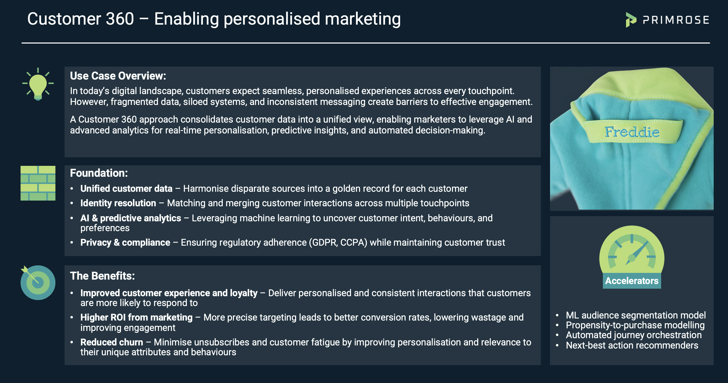
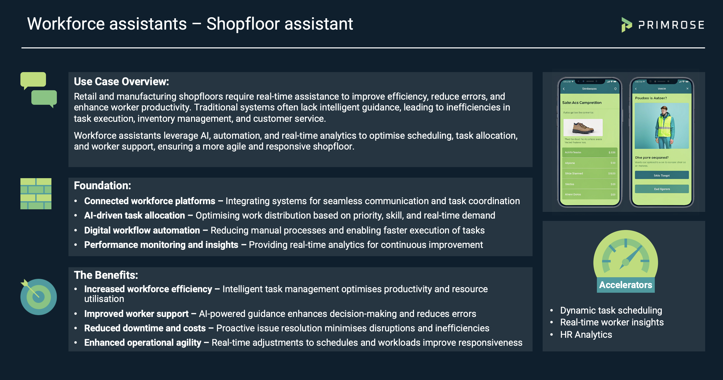
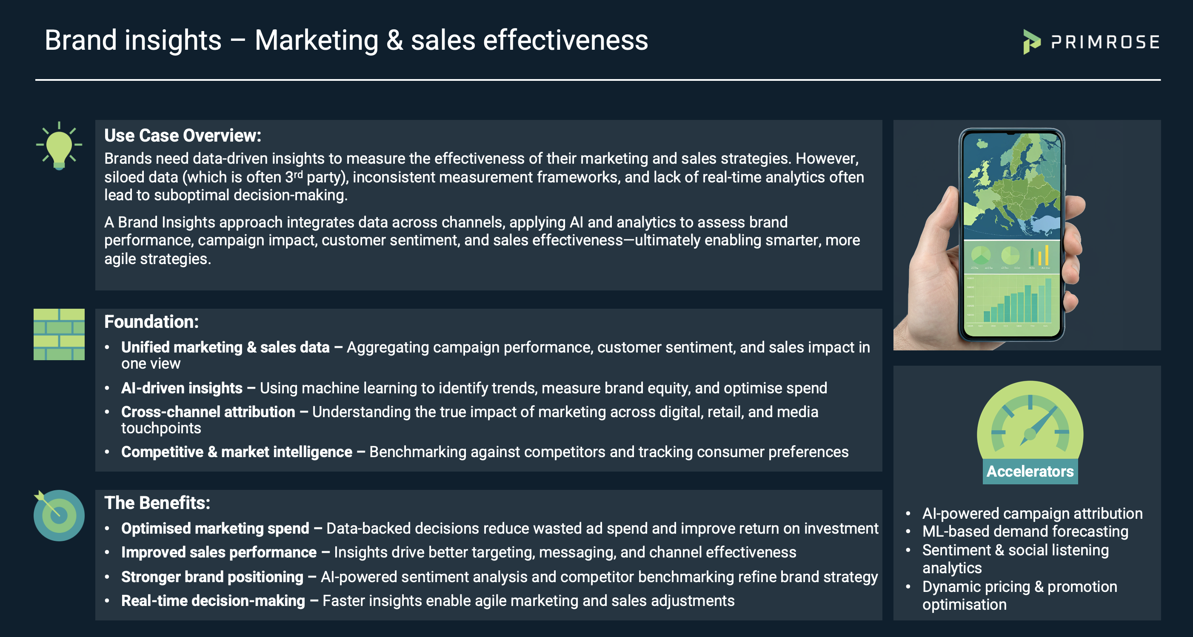
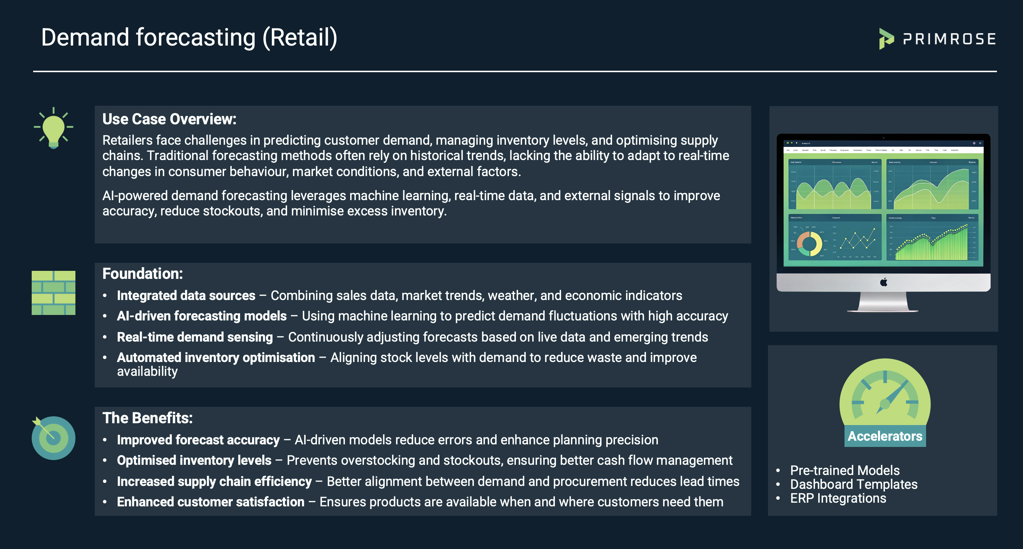
Example Retail & CPG Use Cases
Full presentations available for these use cases
Notes:
[CPG]

Slide 8
Primrose Services
Strategy
Foundations
Automation
What are we trying to achieve
-------
How should we prioritise
-------
How should we operate
Data Assets
-------
Data Quality
-------
Data Governance
-------
Business Intelligence
Process Automation
-------
Agentic AI
-------
Machine Learning
-------
Decision Intelligence
Notes:
[*]

Slide 9



We start with a strategy...
Data & AI Strategy
Data strategy is a blueprint to define and execute your vision for data while delivering against your business objectives. It enables your organisation to leverage data to inform simpler, better and faster decisions, ultimately driving business value.
How this is enabled
We use our strategy framework to ensure we have considered all the components to operationalising your vision for data and ensuring that data efforts are anchored to business value. We can create an end-to-end data strategy which covers all data capabilities, or a more focused strategy for example, Analytics and AI Strategy or Data Security and Privacy Strategy.
Where do we want to get to?
Example Areas of Inquiry:
What are our top business priorities for the next year? What are key business challenges we face?
How can data help us achieve those goals?
What is our defined vision for data?
Benefits to enabling a strategy
Establish a vision for data and a clear plan of execution
Get a full view of data capabilities (people, processes, architecture, data quality etc.)
Ensure data initiatives are always anchored to business value
Co-creation brings the organisation on the journey
Example Areas of Inquiry:
What data do we have? Where is it stored and how is it used?
How can we structure our data people and processes to support business objectives?
What principles, policies and ownership is required?
What should we focus on?
How can we get there?
Example Areas of Inquiry:
Do we have a clear understanding of the short, medium and long terms activities required to achieve our data vision?
What resources are required to execute our vision for data?
Notes:
[*]

Slide 10


…enable the supporting foundations
Data Foundations
Data foundations give your business the building blocks for success with data.
Reusable data assets of high quality with governance that are modelled to the specifics of how your business operates.
How this is enabled
Building from the strategy we work in a prioritised order to deliver the fundamentals to support the data outcomes the business requires to deliver on the strategy and its targets.
How will this be implemented:
Map out source systems and external data providers,
Define required measures and KPIs
How can get data source support the business outcomes required
Create lineage and transformation documentation
What data is required?
Benefits to enabling foundations
Reusable data assets representing a single source of truth.
Frameworks for data quality, governance and development practices.
Technology suitable for supporting an evolving business with operating model.
Co-creation brings the organisation on the journey
How will this be implemented:
Assign roles and responsibilities for the data sources and data assets
Create frameworks to support governance of data, including security, retention, cost management and quality
Consider change management and impact on organisation
Implement operating model of data processes
How will it be managed?
What Technology is required?
How will this be implemented:
Align the technology to the requirements from governance, ensuing it is adaptable and scalable.
What works for our users, support teams, and developers
Notes:
[*]

Slide 11
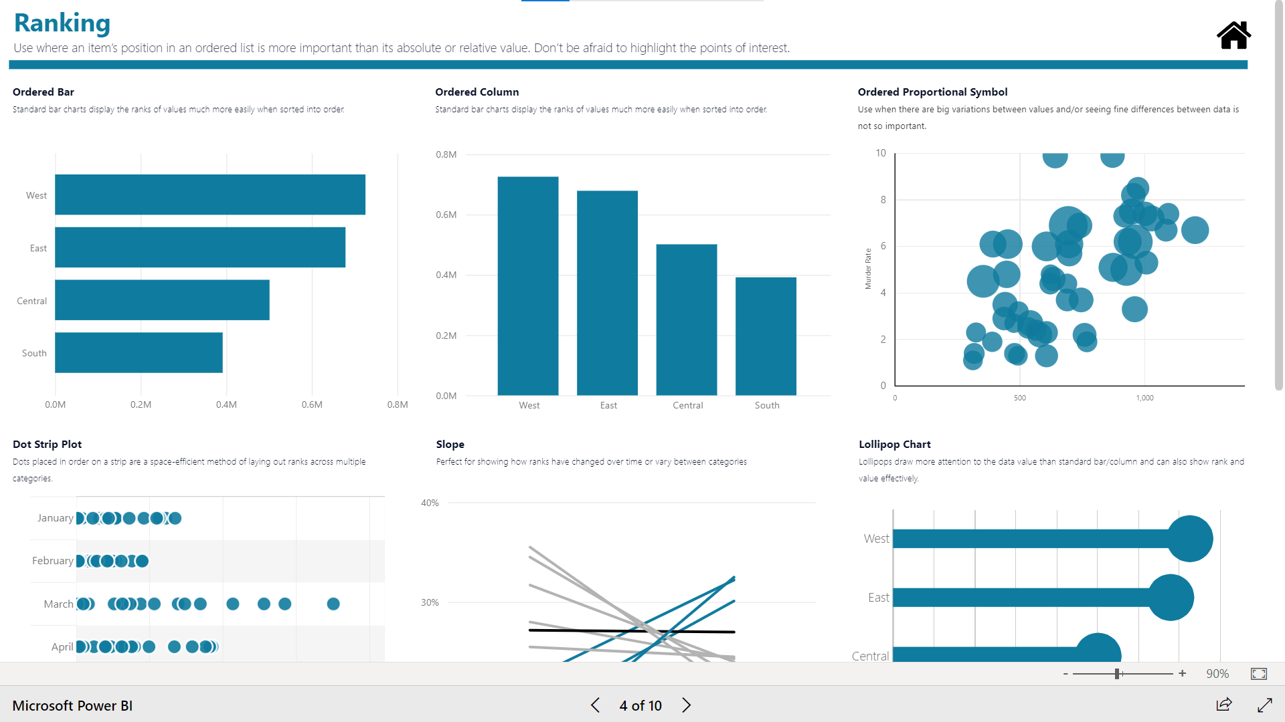
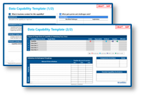
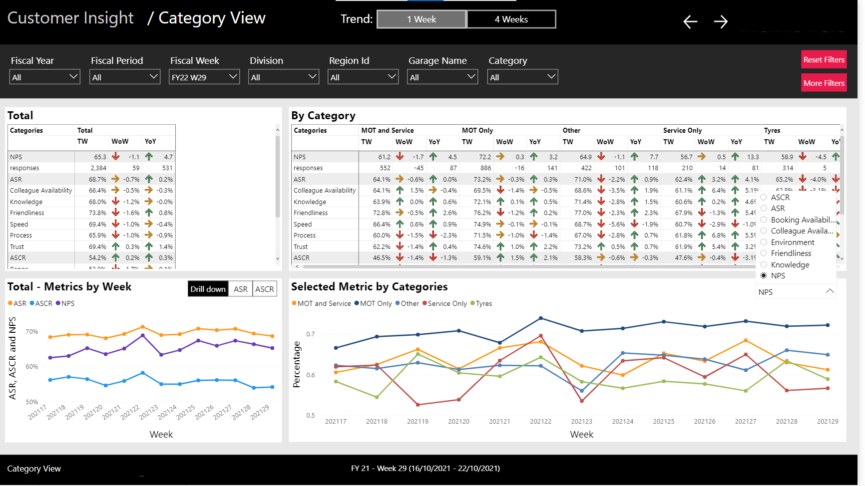

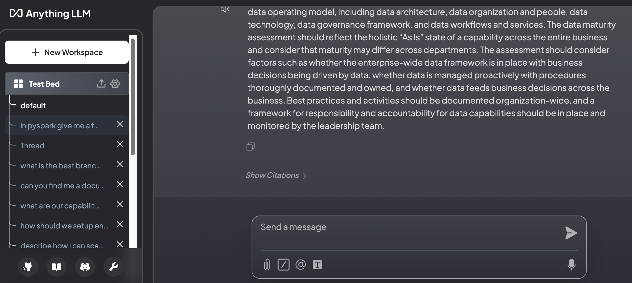
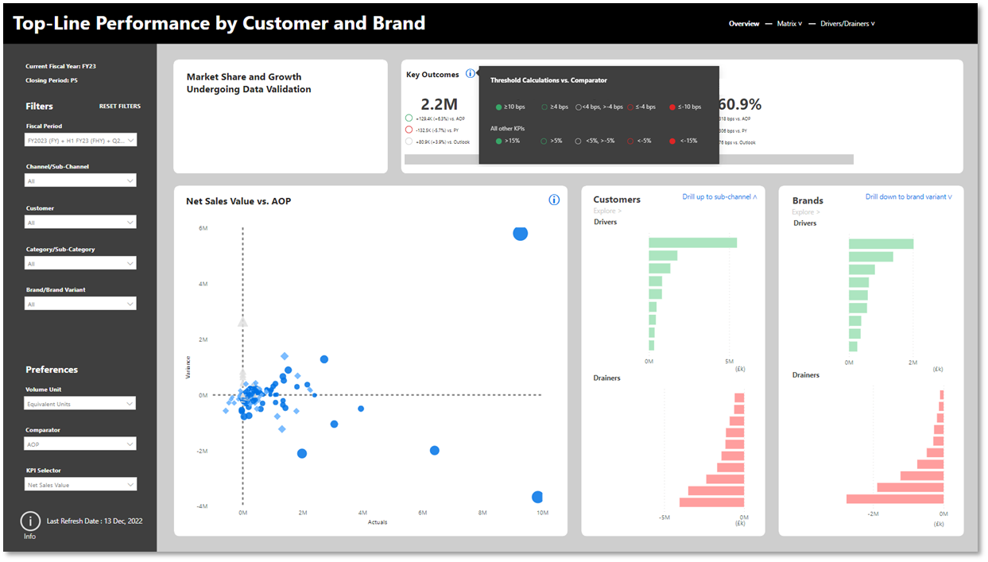




…and build trustable analytics products
Together we design your Analytics Products, this could be one or more:
Dashboard Suite
Descriptive Analytics targeted at specific users, or business processes
Self Service Data Model
Power your internal teams by democratising data
Predictive Model
Such as a Machine Learning model to forecast demand or pricing optimisation
Digital Twin
Simulate a process or change to quickly understand the impact at minimal cost
AI Agents
Create automated agents to respond and process requests unique to your business
Our approach
Discovery
Design
Build
Run
Our consultants understand the requirements from each of your data sources, and understand how it can be accessed
We create designs including mock UI’s and data models for you to approve
Our engineers build the components required to deliver the product. This is done is an iterative process with regular checkpoints.
Upon approval the Product is deployed where we monitor and maintain it. Including ongoing small changes.
Notes:
[*]

Slide 12




Get in touch
Simon D’Morias
Head of Delivery
With 25 years of experience, Simon specialises in delivery of transformational data & AI projects.
Previously, he led major projects and initiatives at Redkite and Accenture, working with global enterprises across Insurance, CPG, and Media.
A Microsoft Certified Master and expert with Databricks and Google technologies, he combines deep technical knowledge with strategic insight.
Simon also holds a BSc in Computer Science.
Sonia Patel
Head of GTM and AI Strategy
Sonia is a seasoned Data and AI specialist with over 7 years of experience and brings a unique blend of technical expertise and commercial acumen to the table. With a deep specialisation in Generative AI, Sonia has been at the forefront of shaping innovative data and AI strategies for organisations across industries.
From developing scalable AI solutions to advising on the architecture of composable CDPs, Sonia's work continues to empower businesses to unlock the full potential of their data assets and transform their operations in an increasingly data-driven world.
Kris Przysowa
AI Engineering
With 20+ years of experience, expertise spans data-driven insights, AI, and cloud solutions. Specialties include Generative AI, LangChain, AI Agents, and Databricks for scalable architectures.
Proficient in Data Engineering, Machine Learning, and Process Automation. Skilled in predictive modelling, data visualisation, and DevOps automation. Expertise covers ETL, Data Governance, and Warehousing (Kimball).
PhD in Modelling Optimisation and Simulations at the Warsaw University of Technology
hello@primrose.io
12
Notes:
[*]

Slide 13
Notes:
[*]

